Slide 1
Career Exploration
Sydney DeFranco

Slide 2
Focus 2
Work Interest
- Investigative
-Social
-Enterprising
Values
- Independent
-Stability
-Tangible Results
Leisure
- Sharing (helpers)
-Inquirers (thinkers)
-Eager (persuaders)
Skills
- Mathematics
-Speaking
-Teaching
Personality
- Defined Goals
- Accuracy
- Practical

Slide 3
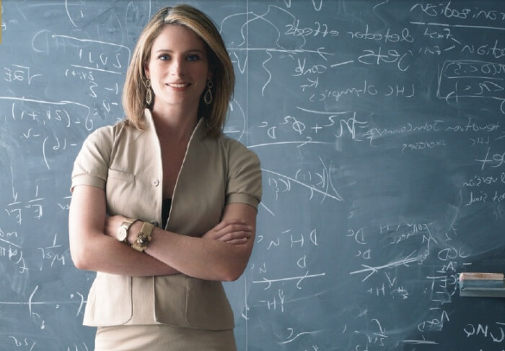
Career Options
Business
Professor
Accountant
Dentist
Notes:
Picture Citations:
Business: https://www.google.com/url?sa=i&rct=j&q=&esrc=s&source=images&cd=&ved=0ahUKEwjsoOCHkp_QAhWHVyYKHR1BBwgQjBwIBA&url=http%3A%2F%2Fwww.chainimage.com%2Fdownload.php%3Fimg%3Dimages%2Fbusiness-woman-clipart-successful-business-woman-business-woman.jpg&psig=AFQjCNHSxgBSPOD2ZGWgv2byq6wftjeKjw&ust=1478899912873786&cad=rjt
Dentist:
http://prevdentspec.com/wp-content/uploads/2016/02/dentist-smiling.jpg
Professor:
http://www.bestmastersdegrees.com/wp-content/uploads/2016/01/Lisa-Randall-Most-Innovative-Women-Professors.jpg
Accountant:
http://www.atsaccountinginc.com/wp-content/uploads/2015/11/find-an-accountant.jpg

Slide 4
What Next?
Apply to the B school!
Notes:
http://www.kenan-flagler.unc.edu/~/media/Images/Featured%20Content/Medium/ed-about-sign2.jpg

